Slide 1
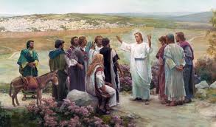
The Commissions of Christ 1

Slide 2
The Commissions of Christ 2
Matthew 10:1-14: (Read)
1. He called his twelve disciples to him and gave them authority to drive out evil spirits and to heal every disease and sickness.
5-6. These twelve Jesus sent out with the following instructions: "Do not go among the Gentiles or enter any town of the Samaritans. Go rather to the lost sheep of Israel.”
7. As you go, preach this message: `The kingdom of heaven is near.'

Slide 3
The Commissions of Christ 3
8. Heal the sick, raise the dead, cleanse those who have leprosy, drive out demons. Freely you have received, freely give.
9-10. Do not take along any gold or silver or copper in your belts; take no bag for the journey, or extra tunic, or sandals or a staff; for the worker is worth his keep.
Compare Matthew 10:1-10 with Luke’s account.
Question: What are the differences? And why?

Slide 4
The Commissions of Christ 4
Luke 9:1-3:
1. When Jesus had called the Twelve together, he gave them power and authority to drive out all demons and to cure diseases, and he sent them out to preach the kingdom of God and to heal the sick.
3. He told them: "Take nothing for the journey--no staff, no bag, no bread, no money, no extra tunic.
Questions: What is missing? And why?

Slide 5
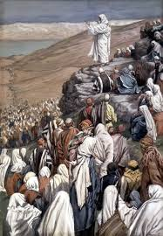
The Commissions of Christ 5
"Do not go among the Gentiles or enter any town of the Samaritans. Go rather to the lost sheep of Israel.”

Slide 6
The Commissions of Christ 6
Luke 10:1-4:
1. After this the Lord appointed seventy-two others and sent them two by two ahead of him to every town and place where he was about to go.
3. Go! I am sending you out like lambs among wolves.
4. Do not take a purse or bag or sandals; and do not greet anyone on the road.
Question: Were they directed to the same people as the Twelve? To whom did they go?

Slide 7
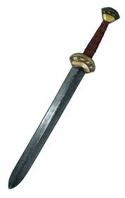
The Commissions of Christ 7
The end of those commissions:
Luke 22:
35: Then Jesus asked them, "When I sent you without purse, bag or sandals, did you lack anything?"
"Nothing," they answered.
36. He said to them, "But now if you have a purse, take it, and also a bag; and if you don't have a sword, sell your cloak and buy one.”

Slide 8
The Commissions of Christ 8
A new commission: Matthew 28:16-20: (Read)
16. Then the eleven disciples went to Galilee ... Jesus came to them and said, "All authority in heaven and on earth has been given to me.
19. Therefore go and make disciples of all nations, baptizing them in the name of the Father and of the Son and of the Holy Spirit,
20. and teaching them to obey everything I have commanded you. And surely I am with you always, to the very end of the age."

Slide 9
The Commissions of Christ 9
Questions:
When was / is the end of the age?
What had Jesus commanded and taught them to do which they had to teachers others?
Did they make disciples of all nations?

Slide 10
The Commissions of Christ 10
Did they make disciples of all nations?
No! So were they disobedient?
Go and make disciples out of all \ from all nations?
Did they do that? Who did Christ want them to witness to? Jews or Gentiles?
What did Christ want them to do?
teaching them (i.e. The new converts) to obey everything I have commanded you.

Slide 11
The Commissions of Christ 11
But what had Christ commanded and taught the Twelve?
Matthew 5:17-20: (Read)
17. "Do not think that I have come to abolish the Law or the Prophets; I have not come to abolish them but to fulfill them.
18. I tell you the truth, until heaven and earth disappear, not the smallest letter, not the least stroke of a pen, will by any means disappear from the Law until everything is accomplished.

Slide 12
The Commissions of Christ 12
19. Anyone who breaks one of the least of these commandments and teaches others to do the same will be called least in the kingdom of heaven, but whoever practices and teaches these commands will be called great in the kingdom of heaven.
20. For I tell you that unless your righteousness surpasses that of the Pharisees and the teachers of the law, you will certainly not enter the kingdom of heaven.

Slide 13
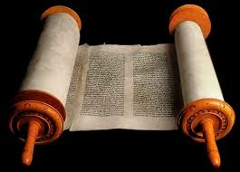
The Commissions of Christ 13
Thus the commission of Matthew 28 was for them was to make disciples of Jews from out of the nations ... And teach them to obey the Law of Moses
i.e. Evangelise the diaspora
And this, as we shall see, is exactly what they did.
Acts 21:20:, "You see, brother, how many thousands of Jews have believed and all of them are zealous for the law.”
But how did they do it?

Slide 14
The Commissions of Christ 14
Another commission? Acts 1:6-8
6-7. So when they met together, they asked him, "Lord, are you at this time going to restore the kingdom to Israel?” He said to them: “It is not for you to know the times or dates the Father has set by his own authority.”
8. But you will receive power when the Holy Spirit comes on you; and you will be my witnesses in Jerusalem, and in all Judea and Samaria, and to the ends of the earth."

Slide 15
The Commissions of Christ 15
Jerusalem ... Judea ... Samaria ... The end of the earth.
What about Galilee?
Earth is ge which can mean the world (earth) or a land or a country.
Jerusalem ... Judea ... Samaria ... The ends of the land [end of the country ; i.e. Galilee]
So what did the Twelve do?

Slide 16
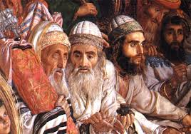
The Commissions of Christ 16
Acts 2:5-11 (Read)
V 2. Now there was staying in Jerusalem God-fearing Jews from every nation under heaven.
V 11: both Jews and converts to Judaism
V 22: Men of Israel

Slide 17
The Commissions of Christ 17
Acts 2:36-41 (Read)
Vs 38. Repent and be baptised.
V 41. 3,000 added to their number
V 47. And the Lord added to their number daily those who were being saved.
4:4. The number of men grew to about 5,000.
Note: They were carrying out the commission of Matthew 28. [What about other Feast days?]

Slide 18
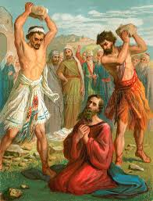
The Commissions of Christ 18
Very soon ... problems with the Jewish authorities
Peter and John imprisoned
Stephen stoned
Great persecution - Saul
James beheaded

Slide 19
The Commissions of Christ 19
A new two-part commission
Acts 9:15
This man [Saul - Paul] is my chosen instrument to carry my name ...
before the Gentiles and their kings and
before the people of Israel.

Slide 20
The Commissions of Christ 20
Gentile nations and witness there to both Jews and Gentiles.
Question: Isn’t this just duplicating what the Eleven / Twelve were commission to do?
Answer: Which region(s) did Paul go to?
Compare with the nations / countries / regions / cities listed in Acts 2.
Antioch in Pisidia; Iconium; Lystra; Derbe .
John Mark left them before. Why?

Slide 21
The Commissions of Christ 21
Acts 16:6: Paul prevented from going into Asia; why?
Acts 2:9 – Jews from Asia there – maybe Epaphras there, or at a later feast.
Acts 16:7; Paul prevented from going into Bithynia; why?
Acts 2:9 Pontus (& Bithynia – one region)
Went on to Troas; Philippi; Thessalonica, Berea, Athens, Corinth, Ephesus – none in Acts 2.

Slide 22
The Commissions of Christ 22
Galatians 2:9:
James, Peter and John, those reputed to be pillars, gave me and Barnabas the right hand of fellowship when they recognized the grace given to me. They agreed that we should go to the Gentiles, and they to the Jews.
Question: But to whom did Paul go?
What was the commission given him by Christ?
Note: ethnos = Gentile people or Gentile nations

Slide 23
The Commissions of Christ 23
The purpose of this two-part commission
Romans 11:11: salvation has come to the Gentiles to make Israel envious.
Romans 11:13-14: I am talking to you Gentiles. Inasmuch as I am the apostle to the Gentiles, I make much of my ministry in the hope that I may somehow arouse my own people to envy and [so] save some of them.

Slide 24
The Commissions of Christ 24
The purpose of this two-part commission
Romans 11:11: salvation has come to the Gentiles to make Israel envious.
Questions:
Is this the purpose / reason for the salvation of Gentiles today?
But back then ... Envy? Why? And did it work?

Slide 25
The Commissions of Christ 25
Why provoke the Jews in the hope they will be saved?
Exodus 19:5-6: Now if you obey me fully and keep my covenant, then out of all nations you will be my treasured possession. Although the whole earth is mine, you will be for me a kingdom of priests and a holy nation.‘
Did it work? Were the Jews provoked into emulating the Gentiles and did the nation become a Kingdom of Priests to the world?

Slide 26
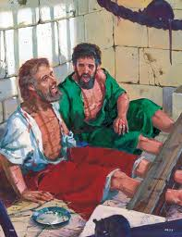
The Commissions of Christ 26
Problems with the Jewish authorities ... High priests ... Sanhedrin ... Herod ... Synagogue rulers
Paul imprisoned, beaten, stoned.
Question: How long could such opposition go on?
Opposed Christ for 3+ years; opposed the apostle for 30+ years

Slide 27
The Commissions of Christ 27
Acts 28:17: Three days later he called together the leaders of the Jews
Acts 28:23-25a: They arranged to meet Paul on a certain day, and came in even larger numbers to the place where he was staying. From morning till evening he explained and declared to them the kingdom of God and tried to convince them about Jesus from the Law of Moses and from the Prophets. Some were convinced by what he said, but others would not believe. They disagreed among themselves and began to leave after Paul had made this final statement:

Slide 28
The Commissions of Christ 28
Acts 28:25b-28a:
"The Holy Spirit spoke the truth to your forefathers when he said through Isaiah the prophet: "`Go to this people and say, "You will be ever hearing but never understanding; you will be ever seeing but never perceiving.“ For this people's heart has become calloused; they hardly hear with their ears, and they have closed their eyes. Otherwise they might see with their eyes, hear with their ears, understand with their hearts and turn, and I would heal them.'
28. "Therefore ...

Slide 29
The Commissions of Christ 29
Acts 28:28: 28. "Therefore I want you to know that God's salvation has been sent to the Gentiles, and they will listen!"
Matthew 28:20: “And surely I am with you always, to the very end of the age.”
Acts 28:25-27: the end of that age
Acts 28:28: the beginning of a new age; something different
A new commission

Slide 30
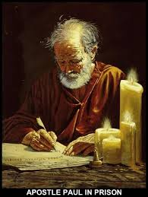
The Commissions of Christ 30
Acts 28:30: For two whole years Paul stayed there in his own rented house ... [And wrote]
Ephesians, Philippians, Colossians, Philemon
He was released and wrote
1 Timothy and Titus
He was re-imprisoned and wrote
2 Timothy

Slide 31
The Commissions of Christ 31
The last commission
Ephesians 3:8-9:
8. Although I am less than the least of all God's people, this grace was given me: to preach to the Gentiles the unsearchable riches of Christ,
9. and to make plain to everyone the administration of this mystery, which for ages past was kept hidden in God, who created all things.

Slide 32
The Commissions of Christ 32
Three of the many new things.
1) Ephesians 3:6: This mystery is that through the gospel the Gentiles are heirs together with Israel, members together of one body, and sharers together in the promise in Christ Jesus.
Note: Jewish and Gentile Christians now are ...
Equal heirs
Equal members
Equal sharers

Slide 33
The Commissions of Christ 33
2) Ephesians 2:14-15
For he himself is our peace, who has made the two one and has destroyed the barrier, the dividing wall of hostility, by abolishing in his flesh the law with its commandments and regulations.
Note: the Law of Moses abolished for the Jewish Christians

Slide 34
The Commissions of Christ 34
3) Ephesians 2:6-7: God raised us up with Christ and seated us with him in the heavenly realms in Christ Jesus, in order that ...
in the coming ages he might show ...
the incomparable riches of his grace, ...
expressed in his kindness to us in Christ Jesus.

Slide 35
The Commissions of Christ 35
Final questions:
So which commission should we be most involved with?
That given to the Twelve in Matthew 10?
That given to the Seventy Two in Luke 10?
That given to the Eleven in Matthew 28 & Acts 1?
That given to Paul in Acts 9?
That given to Paul in Ephesians 3?

