Slide 1
The Apostle to the Gentiles

Slide 2
The Apostle to the Gentiles 2
There is only one person who is called ‘The Apostle to the Gentiles’.
Romans 11:13: I am talking to you Gentiles. Inasmuch as I am the apostle to the Gentiles, I make much of my ministry .
Galatians 3:8: For God, who was at work in the ministry of Peter as an apostle to the Jews, was also at work in my ministry as an apostle to the Gentiles.
Note; Peter an apostle to the Jews – we will return to that later.
But do not misunderstand the word ‘Gentiles’.

Slide 3
The Apostle to the Gentiles 3
Acts 9:15-16: But the Lord said to Ananias, "Go! This man is my chosen instrument to carry my name before the Gentiles and their kings and before the people of Israel. I will show him how much he must suffer for my name."
Galatians 2:9: James, Peter and John, those reputed to be pillars, gave me and Barnabas the right hand of fellowship when they recognized the grace given to me. They agreed that we should go to the Gentiles, and they to the Jews.

Slide 4
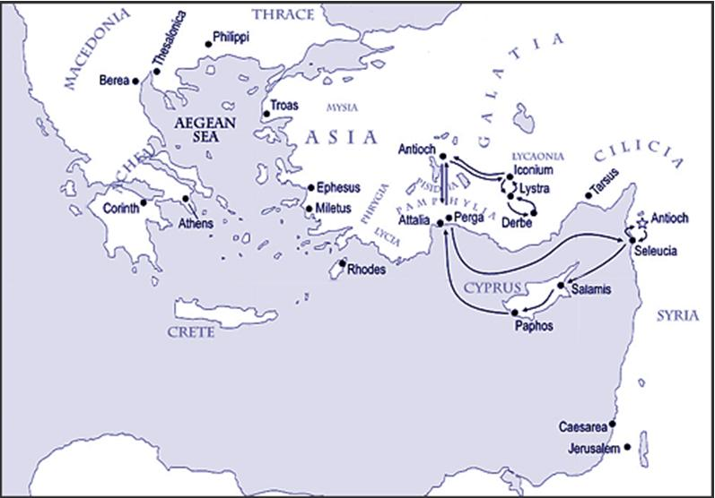
The Apostle to the Gentiles 4
Question: But what happened?
Where did Paul go on his missionary journeys?

Slide 5
The Apostle to the Gentiles 5
But who did he visit first on them? Acts 13:4-7:
The two of them, sent on their way by the Holy Spirit, went down to Seleucia and sailed from there to Cyprus. When they arrived at Salamis, they proclaimed the word of God in the Jewish synagogues ... They travelled through the whole island until they came to Paphos ... Sergius Paulus. The proconsul, an intelligent man, sent for Barnabas and Saul because he wanted to hear the word of God.
Gentiles: ethnos: racial or geographic?

Slide 6
The Apostle to the Gentiles 6
Galatians 2:9: James, Peter and John, those reputed to be pillars, gave me and Barnabas the right hand of fellowship when they recognized the grace given to me. They agreed that we should go to the Gentiles, and they to the Jews.
This is a geographic divide, not a racial one.
Peter, James and John were to stay in Jerusalem and the holy land while Paul went abroad, to the Nations
Galatians 3:8: For God, who was at work in the ministry of Peter as an apostle to the Jews, was also at work in my ministry as an apostle to the Gentiles.

Slide 7
The Apostle to the Gentiles 7
So ... Let’s recap
Matthew 28:18-19:
18. Then Jesus came to them and said, "All authority in heaven and on earth has been given to me.
19. Therefore go and make disciples of all nations, baptizing them in the name of the Father and of the Son and of the Holy Spirit,
20. and teaching them to obey everything I have commanded you. And surely I am with you always, to the very end of the age.“

Slide 8
The Apostle to the Gentiles 8
Note: some say they were disobedient and did not do it. Is that true?
19. Therefore go and make disciples of all nations, baptizing them in the name of the Father and of the Son and of the Holy Spirit,
But we have no record of them leaving Judea, Galilee and Samaria
19. Therefore go and make disciples out of all nations, baptizing them in the name of the Father and of the Son and of the Holy Spirit,
Question: Did they do that?

Slide 9
The Apostle to the Gentiles 9
Colossians 1:6: All over the world this gospel is bearing fruit and growing,
Colossians 1:23: This is the gospel that you heard and that has been proclaimed to every creature under heaven,
Question: How was this done?
Acts 2:5: Now there were staying in Jerusalem God-fearing Jews from every nation under heaven.
Acts 2:41: 3000 were added to their number that day.
Acts 2:47: the Lord added to their number daily
Acts 4:4: the number of men grew to about 5000.

Slide 10
The Apostle to the Gentiles 10
But these were all Jews and they took the message of Jesus being the Christ /Messiah, Son of God back to the own countries, cities, synagogues ... ‘telling the message only to Jews’.
One such person was Epaphras.
Colossians 1:6-7: All over the world this gospel is bearing fruit and growing, just as it has been doing among you since the day you heard it and understood God's grace in all its truth. You learned it from Epaphras.

Slide 11
The Apostle to the Gentiles 11
Acts 9:15: "Go! This man [Pau] is my chosen instrument to carry my name before the Gentiles and their kings and before the people of Israel.”
Question: So what did Paul do?
Acts 9:20: At once he began to preach in the synagogues that Jesus is the Son of God.
Galatians 1:17-18: but I went immediately into Arabia and later returned to Damascus. Then after three years, I went up to Jerusalem.
Question: What did Paul do in Arabia?

Slide 12
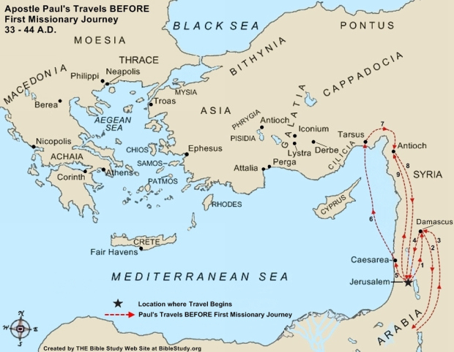
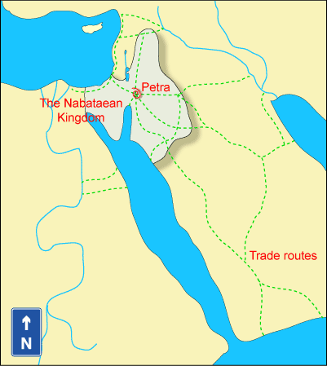
The Apostle to the Gentiles 12

Slide 13
The Apostle to the Gentiles 13
Paul returned to Damascus;
2 Corinthians 11:32-33: In Damascus the governor under King Aretas had the city of the Damascenes guarded in order to arrest me. But I was lowered in a basket from a window in the wall and slipped through his hands.
Acts 9:23-24: 23. After many days had gone by, the Jews conspired to kill him, but Saul learned of their plan. Day and night they kept close watch on the city gates in order to kill him.
Question: Why?

Slide 14
The Apostle to the Gentiles 14
Acts 9:28-29: So Saul stayed with them and moved about freely in Jerusalem, speaking boldly in the name of the Lord. He talked and debated with the Grecian Jews, but they tried to kill him.
Acts 9:30-32: When the brothers learned of this, they took him down to Caesarea and sent him off to Tarsus. Then the church throughout Judea, Galilee and Samaria enjoyed a time of peace. It was strengthened; and encouraged by the Holy Spirit, it grew in numbers, living in the fear of the Lord. As Peter travelled about the country ...

Slide 15
The Apostle to the Gentiles 15
But note: They were all Jews that Paul preached to!
Why? Remember Christ’s words:
Matthew 10:5-6: "Do not go among the Gentiles or enter any town of the Samaritans. Go rather to the lost sheep of Israel.
Matthew 15:24: I was sent only to the lost sheep of Israel.
Matthew 28:19: make disciples of [out of] all nations
Acts 1:8: you will be my witnesses in Jerusalem, and in all Judea and Samaria, and to the ends of the earth (Greek = ge; also translated land or country; i.e. Galilee)

Slide 16
The Apostle to the Gentiles 16
But note: They were all Jews! Why?
Exodus 19:5-6: Now if you obey me fully and keep my covenant, then out of all nations you will be my treasured possession. Although the whole earth is mine, you will be for me a kingdom of priests and a holy nation.
Question: What were they to do as a ‘kingdom of priests’?
This was what God was working towards but ...

Slide 17
The Apostle to the Gentiles 17
Acts 9:31: Then the church throughout Judea, Galilee and Samaria enjoyed a time of peace ...
Questions:
How long? Years, as we shall see.
How many new converts amongst the Jews?
That time of peace was broken by ...

Slide 18
The Apostle to the Gentiles 18
Acts 10:1-2: 1. At Caesarea there was a man named Cornelius, a centurion in what was known as the Italian Regiment. He and all his family were devout and God-fearing; he gave generously to those in need and prayed to God regularly.
An angel appeared to him: Acts 10:3-8
Acts 10:9-16: Peter had a vision.
Acts 10:17-18: Cornelius’ men arrived
Acts 10:19-20: The Spirit spoke to Peter
Acts 1021-23a: Peter invited these men in!

Slide 19
The Apostle to the Gentiles 19
Acts 10:23b-29: Peter went to Cornelius
The comment!
Acts 10:28: He said to them: "You are well aware that it is against our law for a Jew to associate with a Gentile or visit him. But God has shown me that I should not call any man impure or unclean.”
law is not nomos, the word for the Mosaic Law but themitos = that which is established by custom; the Pharisaic additions to the Law

Slide 20
The Apostle to the Gentiles 20
The Question!
Acts 10:29: “May I ask why you sent for me?”
The Opposition!
Acts 11:1-3: The apostles and the brothers throughout Judea heard that the Gentiles also had received the word of God. So when Peter went up to Jerusalem, the circumcised believers criticized him and said, "You went into the house of uncircumcised men and ate with them."
Note: Peter, James, John etc. All affected by the ‘customs’, the ‘traditions’

Slide 21
The Apostle to the Gentiles 21
But that was that! No more Gentiles for Peter and the Jewish Christians in Jerusalem.
Acts 11:19: Now those who had been scattered by the persecution in connection with Stephen travelled as far as Phoenicia, Cyprus and Antioch, telling the message only to Jews.
But then ...
11:2o: Some of them, however, men from Cyprus and Cyrene, went to Antioch and began to speak to Greeks also, telling them the good news about the Lord Jesus.
Question: How well did that go down?

Slide 22
The Apostle to the Gentiles 22
Acts 11:22: News of this reached the ears of the church at Jerusalem, and they sent Barnabas to Antioch.
Question: What was his assessment?
Acts 11:23: When he arrived and saw the evidence of the grace of God, he was glad and encouraged them all to remain true to the Lord with all their hearts.
Question: What was his reaction?
Acts 11:25: Then Barnabas went to Tarsus to look for Saul, and when he found him, he brought him to Antioch.

Slide 23
The Apostle to the Gentiles 23
Questions: Why did Barnabas do that? And how long had Paul been in Tarsus?
How long had Paul been in Tarsus?
Paul sent to Tarsus in Acts 9:30 and came back in 11:26 and then went up to Jerusalem in 11:29-30.
Galatians 1:18: Then after three years, I went up to Jerusalem. [i.e. Three years after his conversion ; the visit of Acts 9:26-30]
Galatians 2:1: Fourteen years later I went up again to Jerusalem. [ 14 years after his previous visit or since his conversion? The visit of Acts 11:29-30]

Slide 24
The Apostle to the Gentiles 24
Why did Barnabas go and fetch Paul?
Acts 9:15: This man is my chosen instrument to carry my name before the Gentiles and their kings and before the people of Israel.
Acts 11:26: So for a whole year Barnabas and Saul met with the church and taught great numbers of people.
Note: fourteen or so years passed between these to events.
Question: What happened next?

Slide 25
The Apostle to the Gentiles 25
Galatians 2:7-9: ... they saw that I had been entrusted with the task of preaching the gospel to the Gentiles, just as Peter had been to the Jews. For God, who was at work in the ministry of Peter as an apostle to the Jews, was also at work in my ministry as an apostle to the Gentiles. James, Peter and John, those reputed to be pillars, gave me and Barnabas the right hand of fellowship when they recognized the grace given to me. They agreed that we should go to the Gentiles, and they to the Jews.

Slide 26
The Apostle to the Gentiles 26
Aside: This is an example of ...
Matthew 18:18-19: "I tell you the truth, whatever you bind on earth will be bound in heaven, and whatever you loose on earth will be loosed in heaven. "Again, I tell you that if two of you on earth agree about anything you ask for, it will be done for you by my Father in heaven. For where two or three come together in my name, there am I with them."
Other examples: appointment of Matthias to replace Judas; the appointment of the seven to sort out the distribution of the food; the Jerusalem council.

Slide 27
The Apostle to the Gentiles 27
Galatians 2:9: They agreed that we should go to the Gentiles, and they to the Jews.
Question: so what happened?
Acts 13:1-4: In the church at Antioch ... While they were worshiping the Lord and fasting, the Holy Spirit said, "Set apart for me Barnabas and Saul for the work to which I have called them.” So after they had fasted and prayed, they placed their hands on them and sent them off. The two of them, sent on their way by the Holy Spirit, went down to Seleucia and sailed from there to Cyprus.

Slide 28
The Apostle to the Gentiles 28
Question: Why Cyprus?
Acts 4:26: Joseph, a Levite from Cyprus, whom the apostles called Barnabas
Acts 11:19-20: Now those who had been scattered by the persecution in connection with Stephen travelled as far as Phoenicia, Cyprus and Antioch, telling the message only to Jews. Some of them, however, men from Cyprus and Cyrene, went to Antioch and began to speak to Greeks also, telling them the good news about the Lord Jesus.

Slide 29
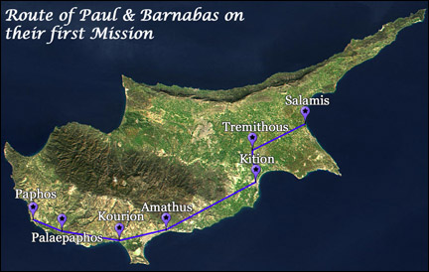
The Apostle to the Gentiles 29
Question; what did they do there?
Acts 13:5-6: When they arrived at Salamis, they proclaimed the word of God in the Jewish synagogues. John was with them as their helper. They travelled through the whole island until they came to Paphos.

Slide 30
The Apostle to the Gentiles 30
The first named Gentile convert on Cyprus.
Acts 13:6-12: ... Paphos. There they met a Jewish sorcerer and false prophet named Bar-Jesus, who was an attendant of the proconsul, Sergius Paulus. The proconsul, an intelligent man, sent for Barnabas and Saul because he wanted to hear the word of God ... [Elymas opposed Paul and was struck blind] ... When the proconsul saw what had happened, he believed, for he was amazed at the teaching about the Lord.

Slide 31
The Apostle to the Gentiles 31
Question: What happened next?
Acts 13:13-16: From Paphos, Paul and his companions sailed to Perga in Pamphylia ... From Perga they went on to Pisidian Antioch. On the Sabbath they entered the synagogue and sat down. After the reading from the Law and the Prophets, the synagogue rulers sent word to them, saying, "Brothers, if you have a message of encouragement for the people, please speak.” Standing up, Paul motioned with his hand and said: "Men of Israel and you Gentiles who worship God, listen to me!” [Note: God-fearing Gentiles]

Slide 32
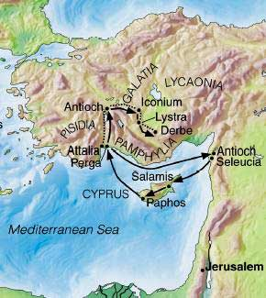
The Apostle to the Gentiles 32
Paul’s first missionary journey

Slide 33
The Apostle to the Gentiles 33
Paul’s first missionary journey:
Acts 13:5: When they arrived at Salamis, they proclaimed the word of God in the Jewish synagogues
Acts 13:14: Pisidian Antioch. On the Sabbath they entered the synagogue ... “Men of Israel and you Gentiles that worship God”
Acts 14:1: At Iconium Paul and Barnabas went as usual into the Jewish synagogue. There they spoke so effectively that a great number of Jews and Gentiles believed. [Note: Gentiles in the Synagogue]

Slide 34
The Apostle to the Gentiles 34
Acts 14:6-7: Lycaonian cities of Lystra and Derbe and to the surrounding country, where they continued to preach the good news.
Question: To whom?
Problem in Lystra with pagan Gentiles .
Acts 14:8-18 (Read)

Slide 35
The Apostle to the Gentiles 35
Acts 14:20-26: The next day he and Barnabas left for Derbe. They preached the good news in that city and won a large number of disciples. Then they returned to Lystra, Iconium and Antioch ... After going through Pisidia, they came into Pamphylia, and when they had preached the word in Perga, they went down to Attalia. From Attalia they sailed back to Antioch ...

Slide 36
The Apostle to the Gentiles 36
Problems ... Problems ... Problems ...
1. Bad news from Galatia!
2. Trouble in Antioch!
3. Problems with Peter!
4. Problems with Barnabas!
5. Difficulties in Jerusalem!

Slide 37
The Apostle to the Gentiles 37
1. Bad news from Galatia!
Judaisers in Galatia; i.e. the circumcision group of Jewish Christians.
Belief in Christ was necessary but not sufficient [but note; they are referred to as ‘believers’ as we shall see]
Questions:
What did Paul do about the situation in Galatia? He wrote the letters to the Galatians.
Why didn’t he go back to Galatia then and there?

Slide 38
The Apostle to the Gentiles 38
2. Trouble in Antioch!
Acts 15:1: 1. Some men came down from Judea to Antioch and were teaching the brothers: "Unless you are circumcised, according to the custom taught by Moses, you cannot be saved."
Question: What did Paul do about it?
Answer: ... later

Slide 39
The Apostle to the Gentiles 39
3. Problems with Peter!
Galatians 2:11-12: 11. When Peter came to Antioch, I opposed him to his face, because he was clearly in the wrong. Before certain men came from James, he used to eat with the Gentiles. But when they arrived, he began to draw back and separate himself from the Gentiles because he was afraid of those who belonged to the circumcision group.
Peter!!!
Note: came from James!!!

Slide 40
The Apostle to the Gentiles 40
They had come from James ?????
This was a false claim by the circumcision group.
See Acts 15:24 where James wrote ...
We have heard that some went out from us without our authorization and disturbed you, troubling your minds by what they said.

Slide 41
The Apostle to the Gentiles 41
4. Trouble with Barnabas!
Galatians 2:11-13:
When Peter came to Antioch, I opposed him to his face, because he was clearly in the wrong. Before certain men came from James, he used to eat with the Gentiles. But when they arrived, he began to draw back and separate himself from the Gentiles because he was afraid of those who belonged to the circumcision group. The other Jews joined him in his hypocrisy, so that by their hypocrisy even Barnabas was led astray.

Slide 42
The Apostle to the Gentiles 42
2. Trouble in Antioch
Acts 15:1-2: Some men came down from Judea to Antioch and were teaching the brothers: "Unless you are circumcised, according to the custom taught by Moses, you cannot be saved.” This brought Paul and Barnabas into sharp dispute and debate with them. So Paul and Barnabas were appointed, along with some other believers, to go up to Jerusalem to see the apostles and elders about this question.
Note 1: Barnabas back on track.
Note 2: Paul and Barnabas did not win the argument!

Slide 43
The Apostle to the Gentiles 43
5. Trouble in Jerusalem
Acts 15:5: Then some of the believers who belonged to the party of the Pharisees stood up and said, "The Gentiles must be circumcised and required to obey the law of Moses."
Acts 15:6: The apostles and elders met to consider this question.
Note: The Jerusalem Council

Slide 44
The Apostle to the Gentiles 44
Acts 15:7-9: After much discussion, Peter got up and addressed them: "Brothers, you know that some time ago God made a choice among you that the Gentiles might hear from my lips the message of the gospel and believe. God, who knows the heart, showed that he accepted them by giving the Holy Spirit to them, just as he did to us. He made no distinction between us and them, for he purified their hearts by faith.
Note: Peter back on track ... But this is the last we hear of Peter in Acts. He did write two letters, but these were written to the Jews of the dispersion.

Slide 45
The Apostle to the Gentiles 45
The decision for the Gentiles and the letter: Acts 15:23-29
Note: no circumcision and no Sabbath but four things: abstain from ....
1. food sacrificed to idols;
2. blood;
3. meat of strangled animals;
4. sexual immorality.

Slide 46
The Apostle to the Gentiles 46
Questions:
1. Why these four rules.
2. Why were Jewish Christians continuing to follow the Law of Moses?

Slide 47
The Apostle to the Gentiles 47
Paul’s second Missionary Journey
Syria and Cilicia (including Tarsus)
Derbe, Lystra, Iconium, (Antioch in Pisidia)
Phyrigia and Galatia, Troas
Acts 16:12-13: Philippi – went outside the city to find a place to pray.
Acts 17:1a: Amphipolis & Apollonia and then ...

Slide 48
The Apostle to the Gentiles 48
Acts 17:1b-2: Then Thessalonica ... where there was a Jewish synagogue. As his custom was, Paul went into the synagogue, and on three Sabbath days he reasoned with them from the Scriptures, explaining and proving that the Christ had to suffer and rise from the dead. "This Jesus I am proclaiming to you is the Christ, " he said. Some of the Jews were persuaded and joined Paul and Silas, as did a large number of God-fearing Greeks and not a few prominent women.
Note: The same pattern

Slide 49
The Apostle to the Gentiles 49
Acts 17
10. As soon as it was night, the brothers sent Paul and Silas away to Berea. On arriving there, they went to the Jewish synagogue.
11. Now the Bereans were of more noble character than the Thessalonians, for they received the message with great eagerness and examined the Scriptures every day to see if what Paul said was true.
12. Many of the Jews believed, as did also a number of prominent Greek women and many Greek men.

Slide 50
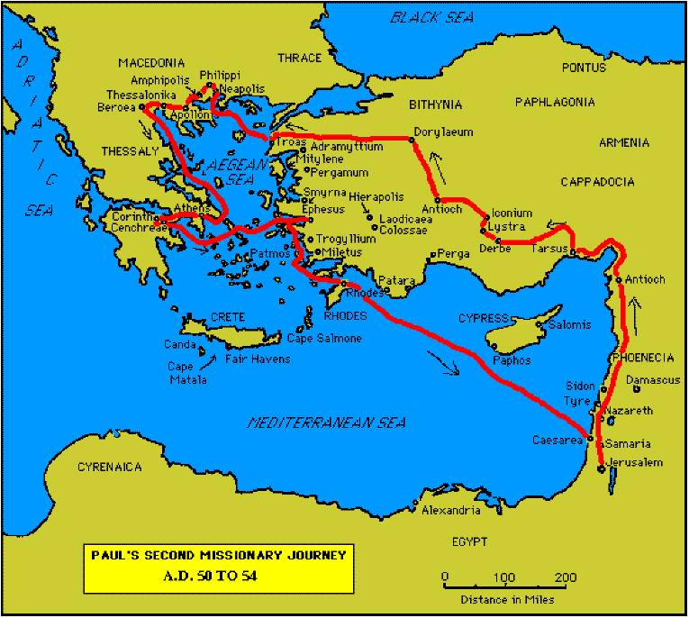
The Apostle to the Gentiles 50
Athens
Corinth
Ephesus
Note 1: The same pattern continues
Note 2: The same response

Slide 51
The Apostle to the Gentiles 51
The response
Some Jews believed as did a number of God fearing Gentiles.
In places we read of the occasional pagan Gentile believing; e.g. The Philippians jailor; a few of the intellectuals on Mars Hill in Athens.
But invariably the Jewish leadership rejected the message, opposed the message, and turned on the Apostles ... And persecuted the Jewish Christians.
Question: What was Paul doing? What was the purpose in all this?

Slide 52
The Apostle to the Gentiles 52
God’s plan was for Israel to believe in Christ and become a kingdom of priests (and missionaries) to the Gentile world.
The Jewish leadership rejected the message and miracles of Jesus and crucified Him.
The Jewish leadership in Acts were rejecting the message and miracles of the apostles and were imprisoning them, beating them, stoning them, killing them.
But with the advent of Cornelius and the Paul’s missionary journeys God was trying one more thing.

Slide 53
The Apostle to the Gentiles 53
Romans 11:1-2: I ask then: Did God reject his people? By no means! ... God did not reject his people, whom he foreknew.
Romans 11:11a: Again I ask: Did they stumble so as to fall beyond recovery? Not at all!
Romans 11:11b: Rather, because of their transgression, salvation has come to the Gentiles to make Israel envious.
Salvation to make Israel envious???
“To provoke them to jealousy” [KJV, ASV]

Slide 54
The Apostle to the Gentiles 54
Romans 11:13-14: I am talking to you Gentiles. Inasmuch as I am the apostle to the Gentiles, I make much of my ministry in the hope that I may somehow arouse my own people to envy and save some of them.
Envy? Can be good; can stimulate someone into positive action.
KJV: If by any means I may provoke to emulation them which are my flesh, and might save some of them.
Question: What was going on?

Slide 55
The Apostle to the Gentiles 55
In Antioch in Pisidia:
Acts 13:44-445: On the next Sabbath almost the whole city gathered to hear the word of the Lord. When the Jews saw the crowds, they were filled with jealousy and talked abusively against what Paul was saying.
Acts 13: 46. Then Paul and Barnabas answered them boldly: "We had to speak the word of God to you first. Since you reject it and do not consider yourselves worthy of eternal life, we now turn to the Gentiles.
Envy / jealousy; closely related but there is nothing positive in jealousy.

Slide 56
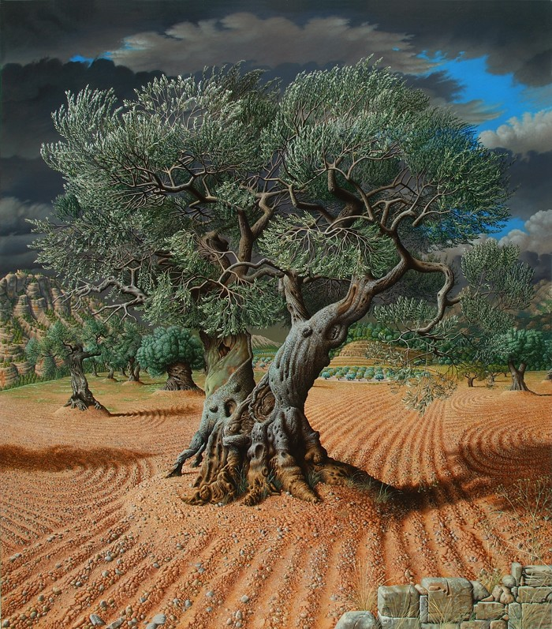
The Apostle to the Gentiles 56
Romans 11:17-18: If some of the branches [of the cultivated olive tree of Israel] have been broken off, and you [Gentiles], though a wild olive shoot, have been grafted in among the others and now share in the nourishing sap from the olive root, do not boast over those branches. If you do, consider this: You do not support the root, but the root supports you.

Slide 57
The Apostle to the Gentiles 57
Note: This passages explains Paul’s ministries during the book of Acts.
He was the Apostle to the Gentiles (geographical, not racial) to those in the nations (both Jews and Gentiles) outside of Jerusalem, Judea, Samaria and Galilee.
This was all in accordance with the commission Gave him in Damascus:
Acts 9:15: This man is my chosen instrument to carry my name before the Gentiles and their kings and before the people of Israel.

Slide 58
The Apostle to the Gentiles 58
Paul: the perfect person for the job.
1. A Jew of the tribe of Benjamin, a Pharisee of the Pharisees who was advancing in Judaism above others of his own age; who had sat at the feet of Gamaliel in Jerusalem.
2. Born an educated in Tarsus in Cilicia into a family who has the status of Roman citizens and was educated in the philosophers, poets of the Greek world.
3. The worst of sinners who persecuted the church and killed Jewish and so experienced grace & forgiveness.

Slide 59
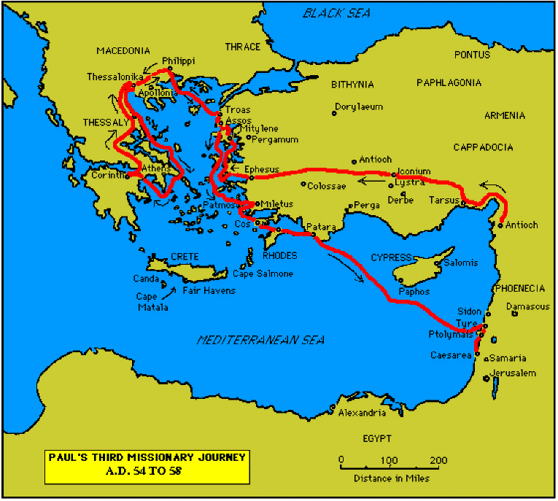
The Apostle to the Gentiles 59
Paul’s Third Missionary Journey
Mainly revisiting previous places

Slide 60
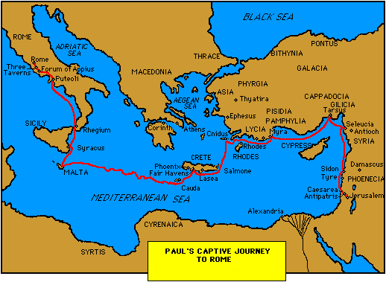
The Apostle to the Gentiles 60
Paul’s Journey to Rome

Slide 61
The Apostle to the Gentiles 61
Paul in Rome
Acts 28: 16-23. When we got to Rome, Paul was allowed to live by himself, with a soldier to guard him. Three days later he called together the leaders of the Jews ... They arranged to meet Paul on a certain day, and came in even larger numbers to the place where he was staying. From morning till evening he explained and declared to them the kingdom of God and tried to convince them about Jesus from the Law of Moses and from the Prophets.
24. Some were convinced by what he said, but others would not believe. [Usual situation!]

Slide 62
The Apostle to the Gentiles 62
Acts 28:25a: They disagreed among themselves and began to leave after Paul had made this final statement:
Acts 28:25b-26: "The Holy Spirit spoke the truth to your forefathers when he said through Isaiah the prophet: "`Go to this people and say,
"You will be ever hearing but never understanding;
you will be ever seeing but never perceiving."
Question; Why not? What was the problem?

Slide 63
The Apostle to the Gentiles 63
Acts 28:27:
For this people's heart has become calloused;
they hardly hear with their ears,
and they have closed their eyes.
Otherwise they might see with their eyes, hear with their ears, understand with their hearts and turn, and I would heal them.'
Israel closed their ears to arguments from Scripture
Israel shut their eyes to the evidence of the miracles

Slide 64
The Apostle to the Gentiles 64
The consequences:
Acts 28:28: "Therefore I want you to know that God's salvation has been sent to the Gentiles, and they will listen!"
Questions:
What happened to the olive tree?
What happened to the Gentile believers who had been grafted in?
What happened to those Jews who had believed?

Slide 65
The Apostle to the Gentiles 65
Acts 28:30: For two whole years Paul stayed there in his own rented house and welcomed all who came to see him.
At the start of those two years he wrote:
Ephesians, Colossians and Philemon and towards the end Philippians.
He was then releases and wrote 1 Timothy & Titus
He was then re –arrested and wrote 2 Timothy
It is these seven letters which tell us about this new situation.

Slide 66
The Apostle to the Gentiles 66
Ephesians 3:8-9:
Although I am less than the least of all God's people, this grace was given me:
to preach to the Gentiles
the unsearchable riches of Christ,
and to make plain to everyone
the administration of this mystery,
which for ages past was kept hidden in God, who created all things.
Unsearchable riches? Mystery? Kept hidden?

Slide 67
The Apostle to the Gentiles 67
Ephesians 3:2-5:
2. Surely you have heard about the administration of God's grace that was given to me for you,
3. that is, the mystery made known to me by revelation, as I have already written briefly [above].
4. In reading this, then, you will be able to understand my insight into the mystery of Christ,
5. which was not made known to men in other generations as it has now been revealed by the Spirit to God's holy apostles and prophets.

Slide 68
The Apostle to the Gentiles 68
Ephesians 3:6:
This mystery is that ...
through the gospel the Gentiles
are heirs together [with Israel],
members together of one body,
and sharers together in the promise in Christ Jesus.
Co-heirs; co-members; co-sharers.
Equal-heirs; equal-members; equal sharers
Question: where did Paul wrote about that ‘above’?

Slide 69
The Apostle to the Gentiles 69
Ephesians 2:14-15:
For he himself is our peace, who has made the two one and has destroyed the barrier, the dividing wall of hostility, by abolishing in his flesh the law with its commandments and regulations. His purpose was to create in himself one new man out of the two, thus making peace.
Question: How did he do this?
Answer: By destroying the barrier, the dividing wall of hostility, by abolishing in his flesh the law with its commandments and regulations.

Slide 70
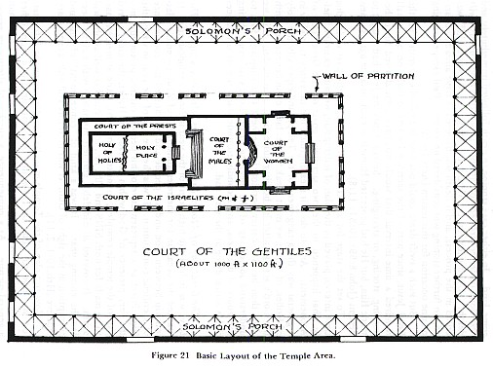
The Apostle to the Gentiles 70

Slide 71
The Apostle to the Gentiles 71
Colossians 2:13-17
13: God made you alive with Christ. He forgave us all our sins,
14. having cancelled the written code, with its regulations, that was against us and that stood opposed to us; he took it away, nailing it to the cross.
16. Therefore do not let anyone judge you by what you eat or drink, or with regard to a religious festival, a New Moon celebration or a Sabbath day.
17. These are a shadow of the things that were to come; the reality, however, is found in Christ.

Slide 72
The Apostle to the Gentiles 72
The Law in Acts ... For Jews; Christian Jews as well as non-Christian Jews. Why?
Temple; Feasts; Sabbath attendance at synagogues; Nazerite vows; circumcision.
E.g. Acts 16:1-3: He came to Derbe and then to Lystra, where a disciple named Timothy lived, whose mother was a Jewess and a believer, but whose father was a Greek. The brothers at Lystra and Iconium spoke well of him. Paul wanted to take him along on the journey, so he circumcised him because of the Jews who lived in that area, for they all knew that his father was a Greek.

Slide 73
The Apostle to the Gentiles 73
Circumcision after Acts
Colossians 2:11: In him [Christ]you were also circumcised, in the putting off of the sinful nature, not with a circumcision done by the hands of men but with the circumcision done by Christ.
Philippians 3:2-3: Watch out for those dogs, those men who do evil, those mutilators of the flesh. For it is we who are the circumcision, we who worship by the Spirit of God.
Titus 1:10: For there are many rebellious people, mere talkers and deceivers, especially those of the circumcision group.

Slide 74
The Apostle to the Gentiles 74
The position of Israel before the end of Acts
The Old Testament – through Israel; Proselytes
The Gospels
Matthew 10: 5-6: "Do not go among the Gentiles or enter any town of the Samaritans. Go rather to the lost sheep of Israel.”
Matthew 15:24: "I was sent only to the lost sheep of Israel."

Slide 75
The Apostle to the Gentiles 75
The position of Israel before the end of Acts
During the Acts Period:
Romans 1:16-17: I am not ashamed of the gospel, because it is the power of God for the salvation of everyone who believes: first for the Jew, then for the Gentile.
Romans 2:9-10: There will be trouble and distress for every human being who does evil: first for the Jew, then for the Gentile; but glory, honour and peace for everyone who does good: first for the Jew, then for the Gentile.

Slide 76
The Apostle to the Gentiles 76
Romans 3:1-2: What advantage, then, is there in being a Jew, or what value is there in circumcision? Much in every way! First of all, they have been entrusted with the very words of God.
Note: during the acts period all leaders, teachers, evangelists etc. were Jews.
After Acts: Titus in charge of Crete and ...
Ephesians 3:6: the Gentiles are heirs together with Israel, members together of one body, and sharers together in the promise in Christ Jesus.

Slide 77
The Apostle to the Gentiles 77
Ephesians 3:8: Although I am less than the least of all God's people, this grace was given me: to preach to the Gentiles the unsearchable riches of Christ,
Ephesians 2:6-7 And God raised us up with Christ and seated us with him in the heavenly realms in Christ Jesus, in order that in the coming ages he might show the incomparable riches of his grace, expressed in his kindness to us in Christ Jesus.
Note: in the heavenly realms

Slide 78
The Apostle to the Gentiles 78

Slide 79
The Apostle to the Gentiles 79

Slide 80
The Apostle to the Gentiles 80

